Slide 1
Graphical analysis of multivariate statistics
By Kim

Slide 2
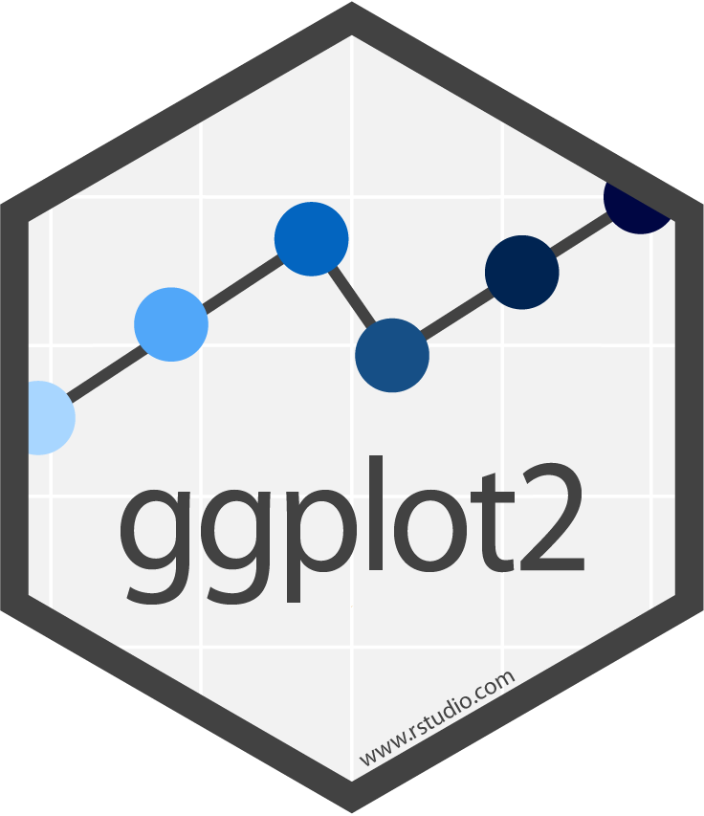
scatterplots made with Ggplot2

Slide 3
The data
Data and analysis done using Stanford University’s online article about Multivariate Analysis in R
Singular-Value Decomposition and Eigendecomposition

Slide 4
R Packages used
ggplot2 (graphics)
ade4 (multivariate analysis)
grid (Viewport)
phyloseq (GlobalPatterns data)

Slide 5

What is singular value decomposition?
See chapter 2 of the applied multivariate textbook
SVD is “expressed as a matrix expansion that depends on the rank r of A. Specifically, there exist r positive constants λi, r orthogonal mx1 unit vectors ui, and r orthogonal kx1 unit vectors vi, for i = 1, …, r, such that $A= \sum_{i=1}^{r}{{\text{λ}}_{i}u_{i}v_{i}^{T}=U_{r}{\text{Λ}}_{r}V_{r}^{T}}$, where $U_{r}=[u_{1}, …,u_{r}]$, $V_{r}=[v_{1}, …,v_{r}]$, and${\text{Λ}}_{r}$ is an rxr diagonal matrix with diagonal entries ${\text{λ}}_{i}$” (pg 100)
$A_{(mxk)}=U_{mxm}{\text{Λ}}_{mxk}V_{kxk}^{T}$

Slide 6
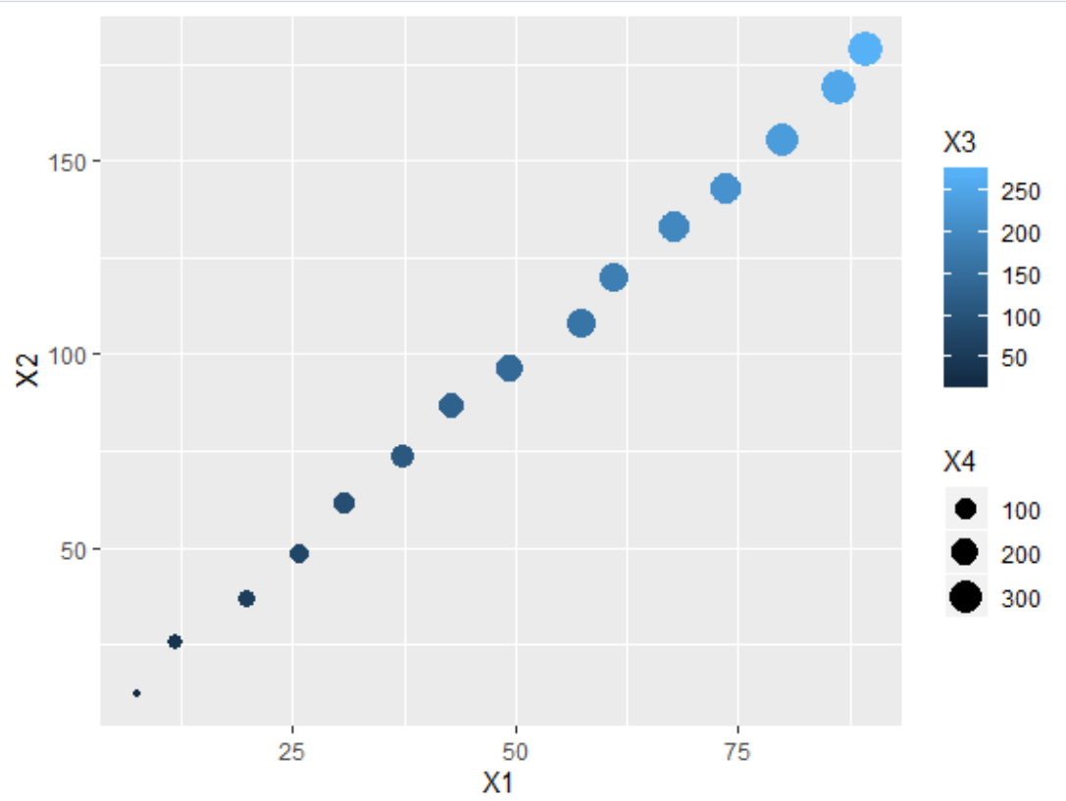
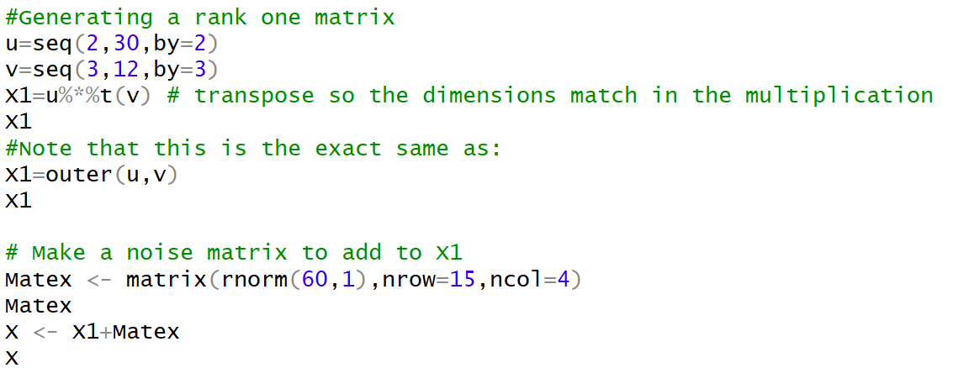
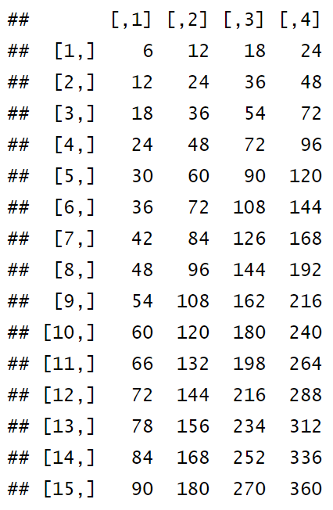
Generate svd data to get a plot
Generate a rank one matrix
“We take a vector of length 15 with values from 2 to 30 in increments of 2, and a vector of length 4 with values 3,6,9,12”.
This gives neat data
Resulting data X is 4 dimensional
Show 4-dimensionality with the color and size in ggplot
ggplot(data=data.frame(X), aes(x=X1, y=X2, col=X3, size=X4)) + geom_point()
Looks linear in all 4 directions, making it rank 1.

Slide 7
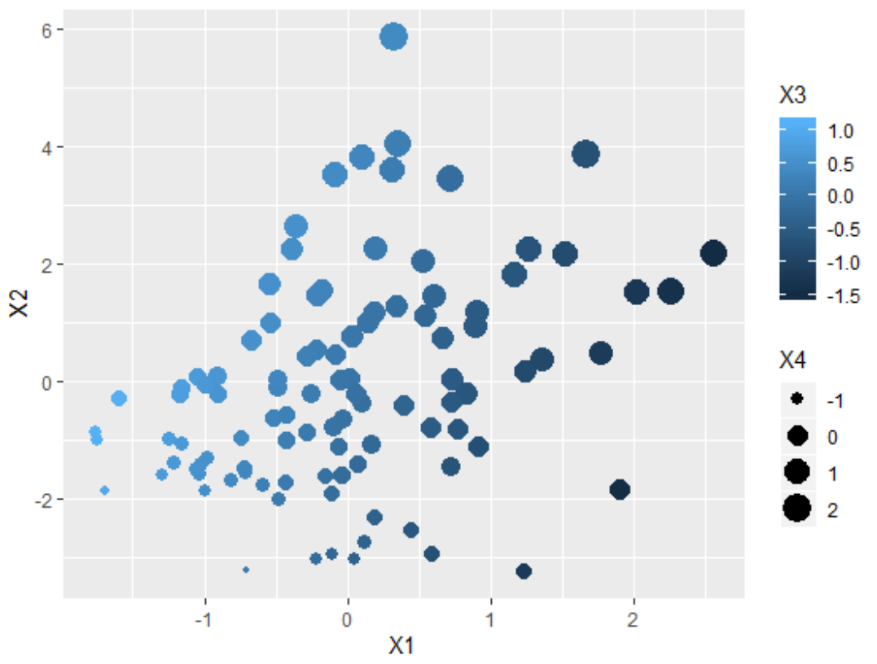
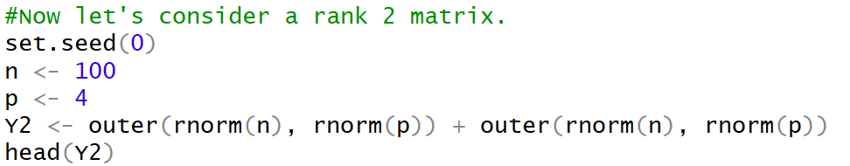
Rank 2 matrix
ggplot(data=data.frame(Y2), aes(x=X1, y=X2, col=X3, size=X4)) + geom_point()
The data is messier and more random
In contrast to previous plot,
Notice that the plot is nonlinear
Dots get darker and larger as X1 gets larger
Notice the scaling of the 4 variables

Slide 8
“As you can probably tell, it is very hard to visually discover a low dimensional space in higher dimensions, even when ‘high dimensions’ only means 4! This is one reason why we rely on the singular value decomposition.” -Stanford article

Slide 9
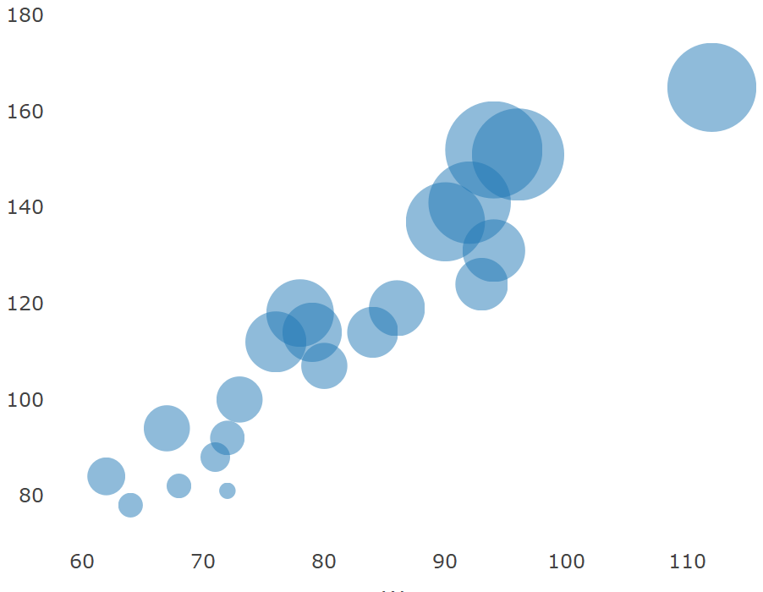
Bubbleplots

Slide 10

The data
Data used was gender gap in earnings at universities (school_earnings.csv) from plotly package datasets

Slide 11
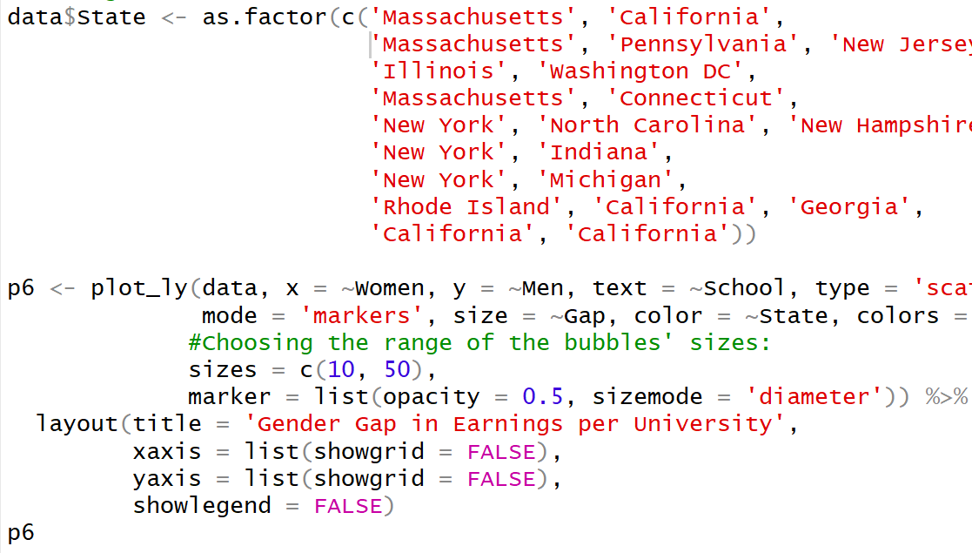
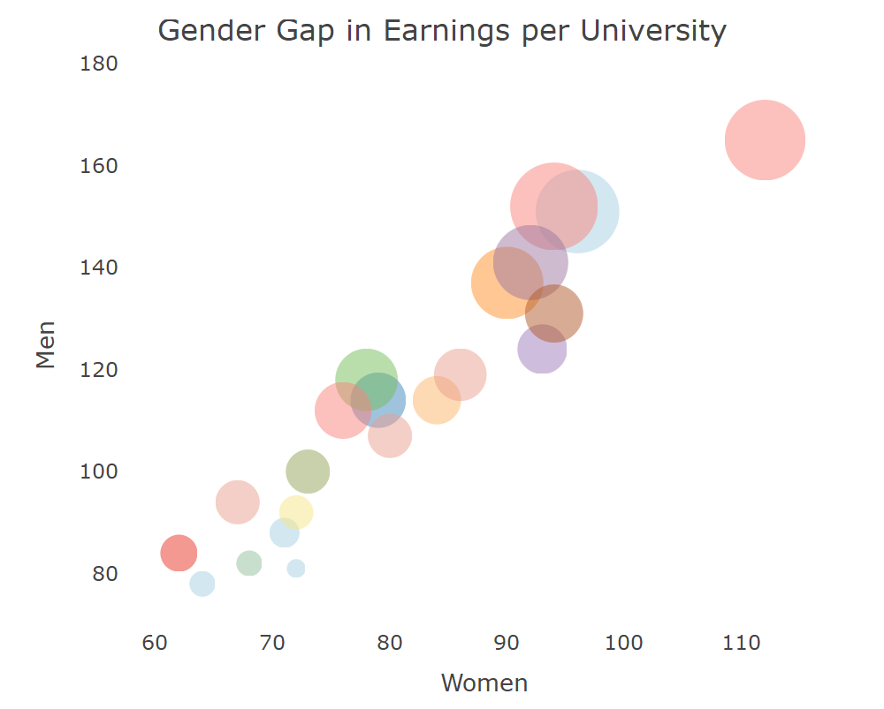
Make a bubble plot
Create a “Gender Gap in Earnings per University” plot, with color as state, size as gap (in $), and x-axis as woman, y-axis as men

Slide 12
Bubble plots
Similar visuals as the ggplot2 graphics
Use color and size to show dimensionality
Shows overlaps

Slide 13
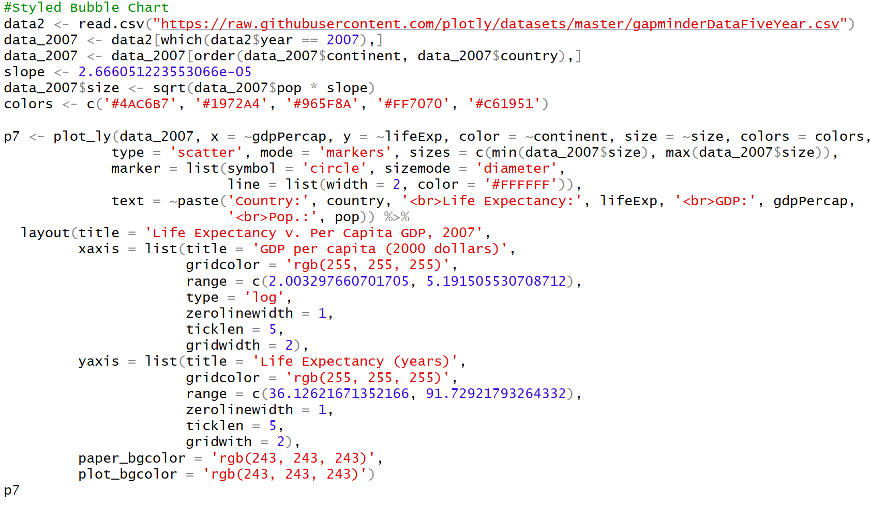
Another bubble plot
gapminder data from plotly package: gapminderDataFiveYear.csv
Life Expectancy v. Per Capita GDP, 2007
X is gdp per capita, y is life expectancy, color is continent, and size is based on the population sizes of the countries

Slide 14
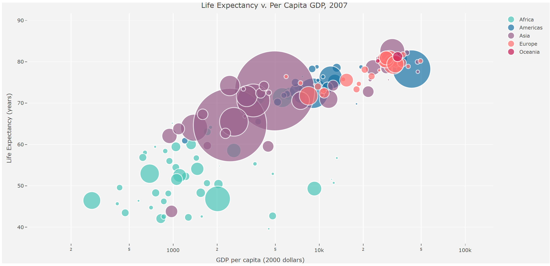

Slide 15
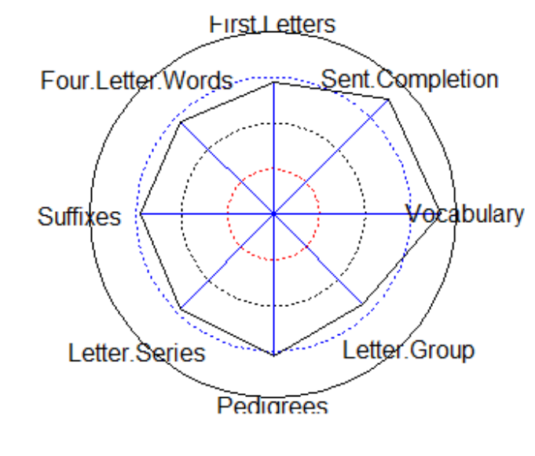
spiderplots

Slide 16
What’s a spiderplot?
Spiderplots are also known as starplots or as webbed radar plots
See the applied multivariate textbook section on stars in chapter 1

Slide 17

Explanation from the textbook
“each data unitconsists of nonnegative observations on p ≥ 2 variables. In two dimensions, we can construct circles of a fixed radius with p equally spaced rays emanating from the center of the circle. The lengths of the rays represent the vzlues of the variables. The ends of the rays can be connected with straight lines to form a star [or spider web]. Each star represents a multivariate observations, and the stars can be grouped accrding to their subjective similarities.”
pg 26, applied multivariate statistical analysis, 6th edition

Slide 18
Data and package used
Package “psych” was used in R
Data Thurstone and bfi were used from the psych package

Slide 19
How the functions work
Radar function: “plots correlations as vectors ranging in length from 0 (corresponding to r=-1) to 1 (corresponding to an r=1). The vectors are arranged radially around a circle.”
Spider function: “Spider plots connect the end points of each vector. The plots are most appropriate if the variables are organized in some meaningful manner.”
Reference: R documentation on spider {psych} package: https://personality-project.org/r/html/spider.html

Slide 20
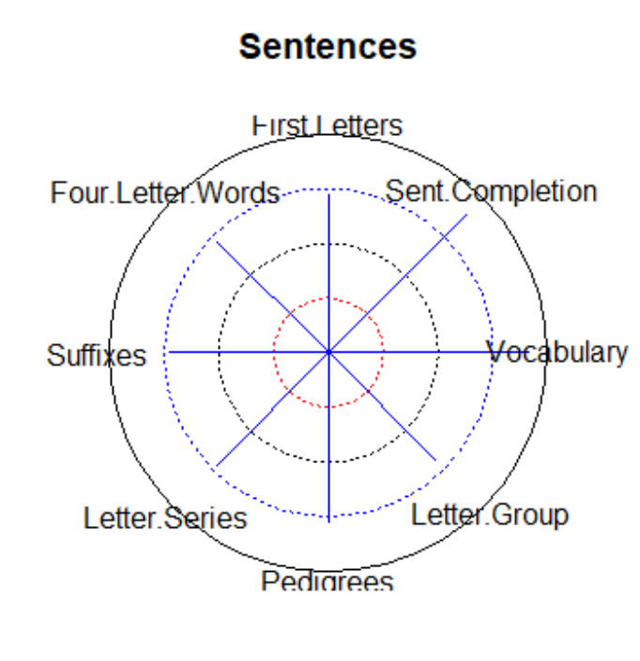
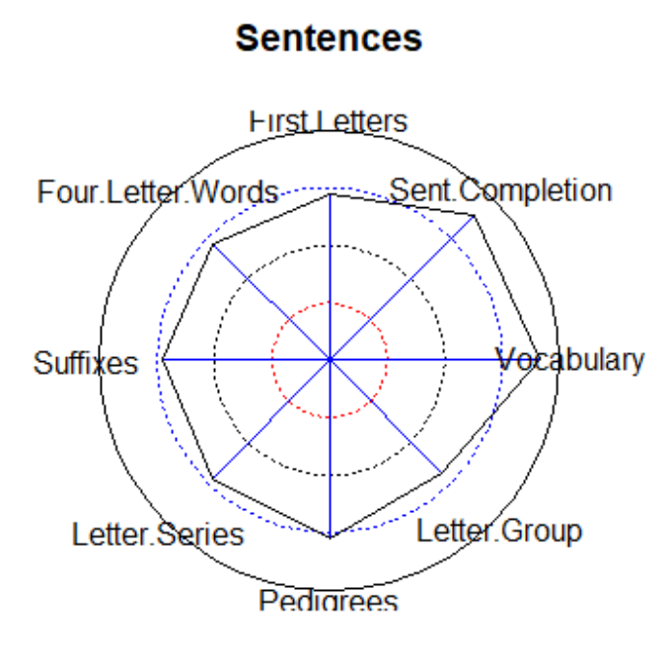
Radar vs. spiderplot
Radar plot
spiderplot
spider(y=1,x=2:9,data=Thurstone,connect=FALSE)
spider(y=1,x=2:9,data=Thurstone)

Slide 21
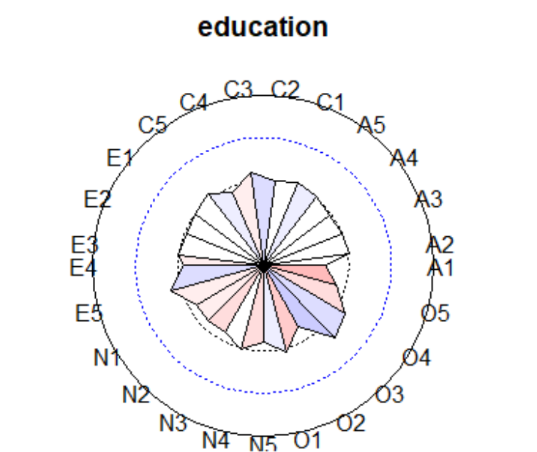
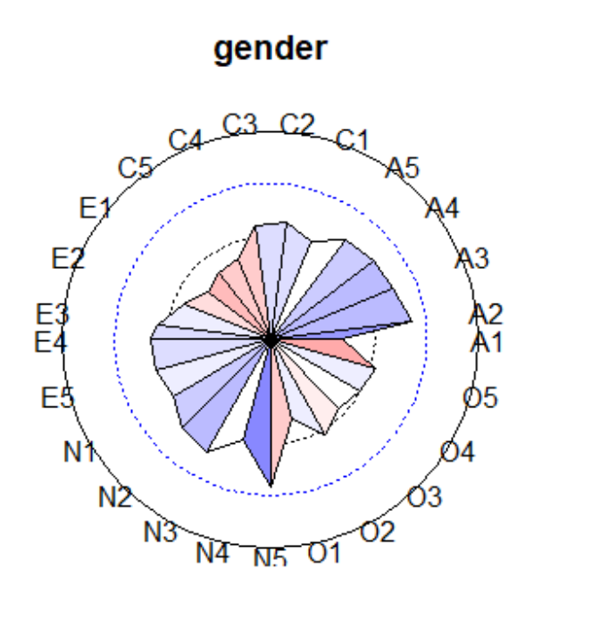
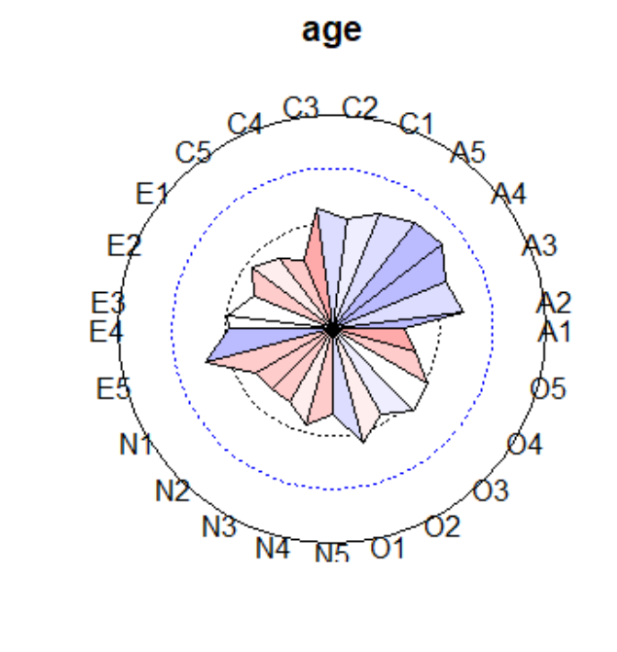
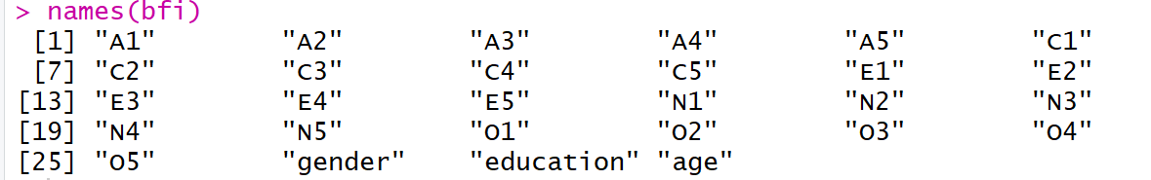
More detailed spiderplots
spider(y=26:28,x=1:25,data=cor(bfi,use="pairwise"),fill=TRUE,scale=2)

Slide 22
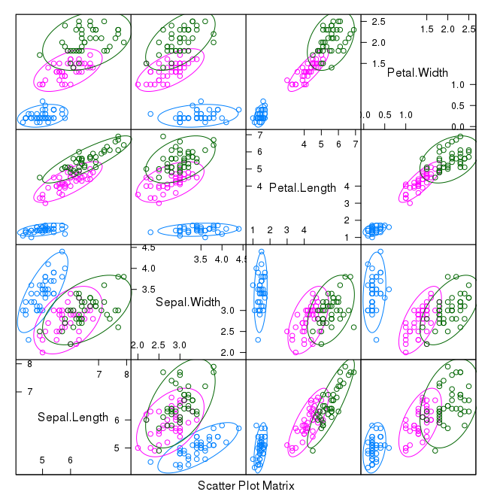
Scatterplot matrix
Image from https://machinelearningmastery.com/machine-learning-in-r-step-by-step/

Slide 23
What is a scatterplot matrix?
See chapter 1 of the applied multivariate statistical analysis 6th edition textbook, pages 16, 20-23.
Shows “two dimensional scatterplots for pairs” of the p > 2 variables, organized as a pxp matrix array.

Slide 24
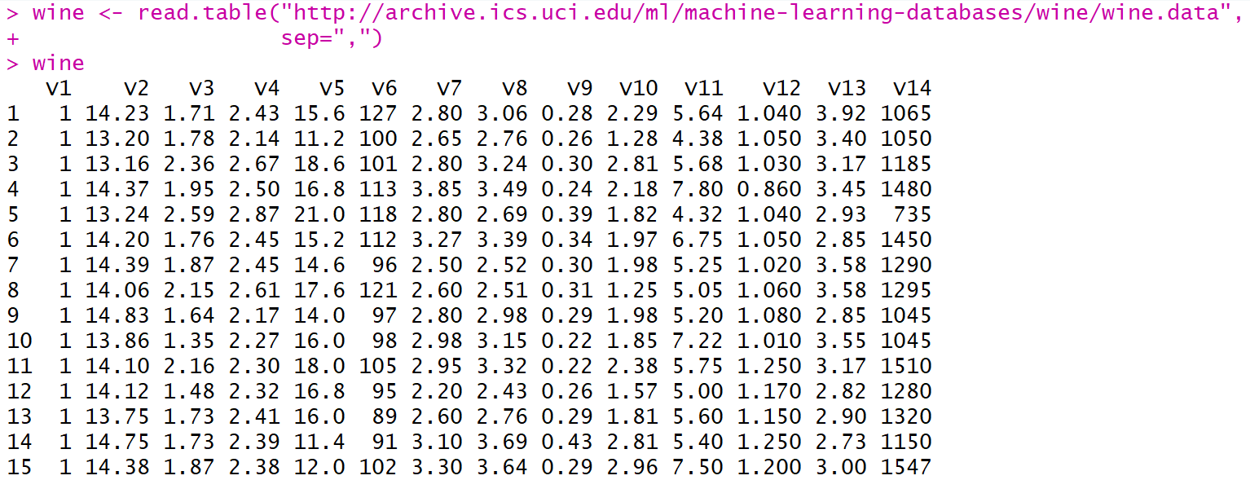
Data, package, and function used
Using the online handbook “Using R for Multivariate Analysis”: https://little-book-of-r-for-multivariate-analysis.readthedocs.io/en/latest/src/multivariateanalysis.html
Package is “car”
Function scatterplotMatrix() was used
Data used is called wine, and comes from: http://archive.ics.uci.edu/ml/machine-learning-databases/wine/wine.data
V2-V14 are all chemicals

Slide 25
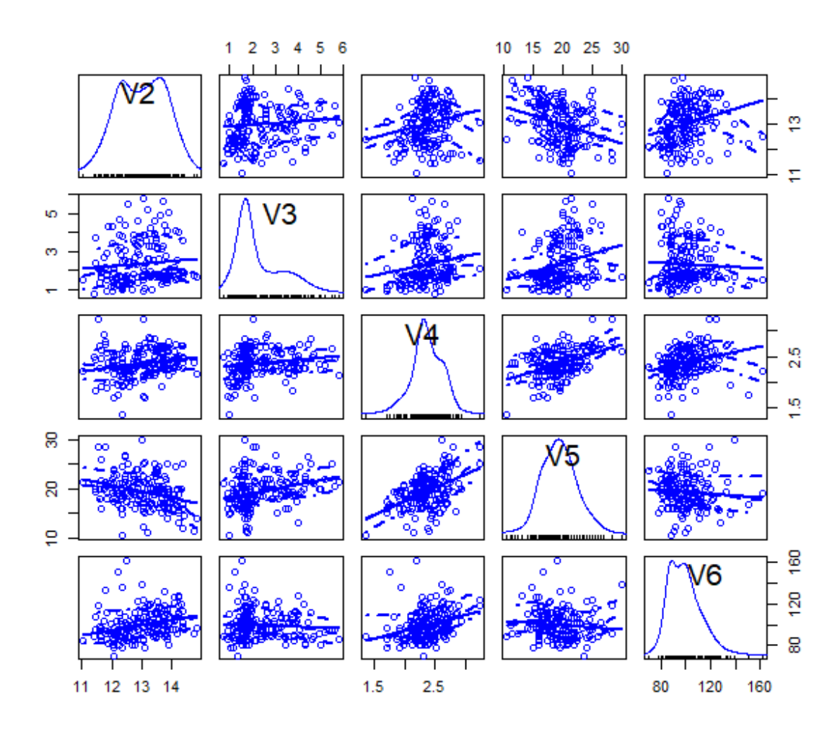
Scatterplot matrix of dataset wine
Concentrations of first 5 chemicals used: V2, V3, V4, V5, V6
scatterplotMatrix(wine[2:6])

Slide 26
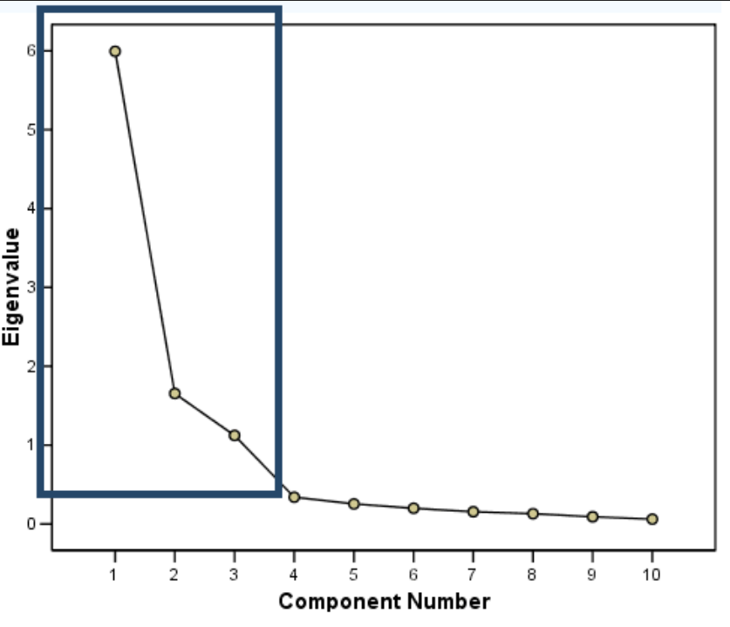
Scree plots for Principal component analysis
Image from http://ba-finance-2013.blogspot.com/2012/09/scree-plots-interpretation-and.html

Slide 27
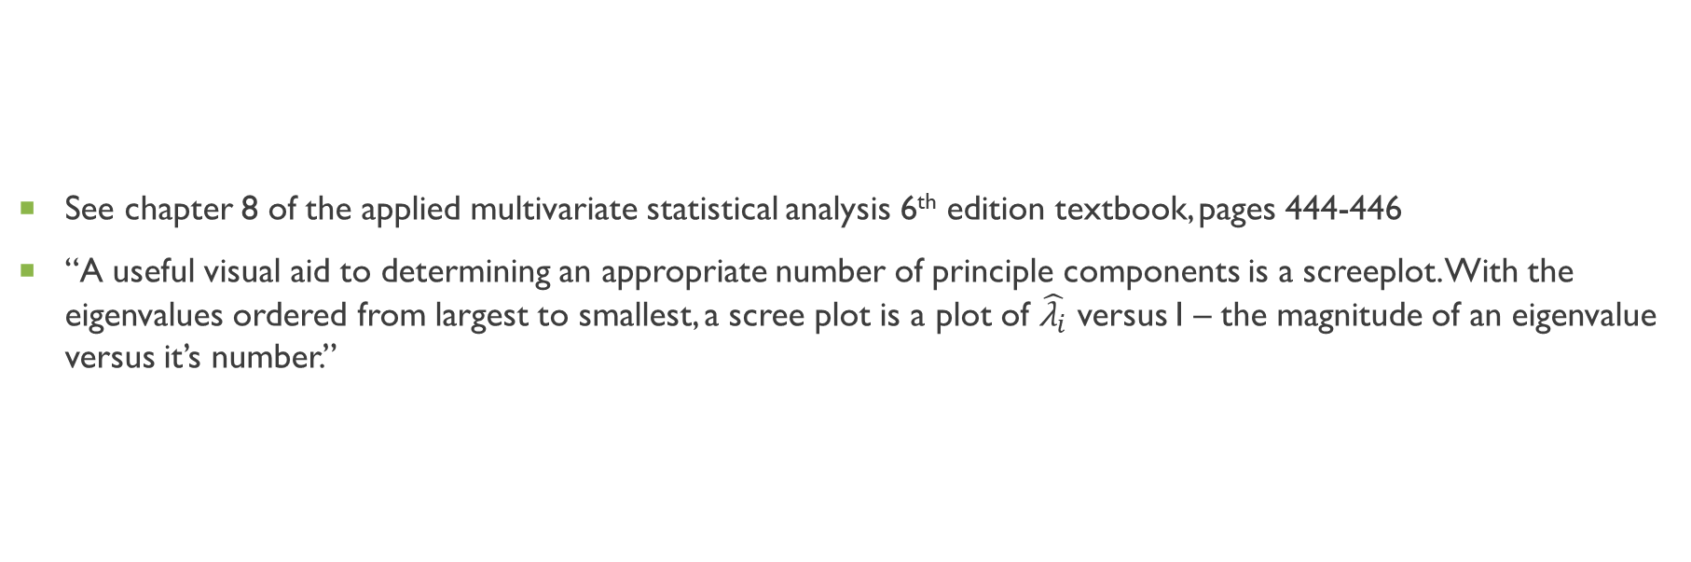
What is a screeplot?
See chapter 8 of the applied multivariate statistical analysis 6th edition textbook, pages 444-446
“A useful visual aid to determining an appropriate number of principle components is a screeplot. With the eigenvalues ordered from largest to smallest, a scree plot is a plot of $\hat{{\text{λ}}_{i}}$ versus I – the magnitude of an eigenvalue versus it’s number.”

Slide 28
How do you use a scree plot?
“To determine the appropriate number of components, we look for an elbow (bend) in the screeplot” (page 445)
The appropriate number of components to be selected are found at thus elbow, the point where the rest of the eigenvalues on the screeplot are about the same size and are relatively small to the components on the left side of the elbow bend.

Slide 29
Recall Data, package, and function used
Using the online handbook “Using R for Multivariate Analysis”: https://little-book-of-r-for-multivariate-analysis.readthedocs.io/en/latest/src/multivariateanalysis.html
Package is “car”
Function screeplot(), prcomp() was used
Data used is called wine, and comes from: http://archive.ics.uci.edu/ml/machine-learning-databases/wine/wine.data
V2-V14 are all chemicals
Wine’s PCs are found

Slide 30
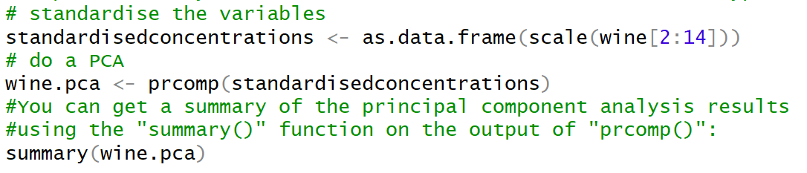
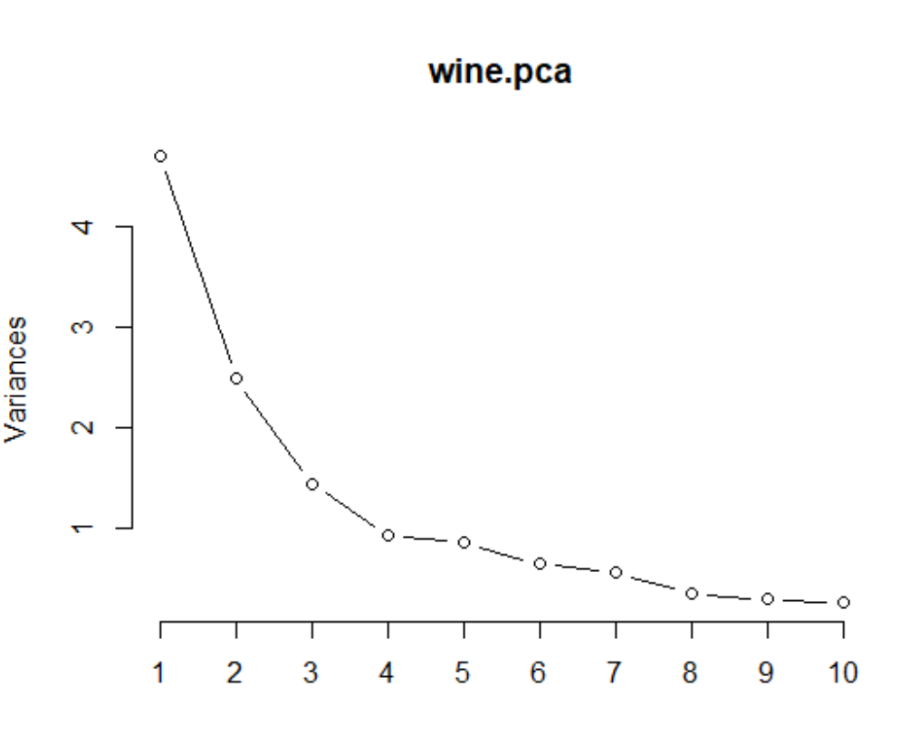
Find wine’s principle components and get screeplot
screeplot(wine.pca, type="lines")
Choose first 3 principal components

Slide 31
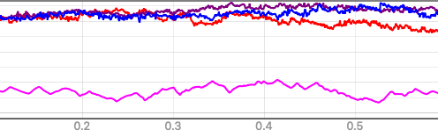
Parallel-line plots
Image from https://forum.step.esa.int/t/relative-heights-to-absolute-heights-in-dem-generation/1956

Slide 32
What is a profile plot?
Plots the value of each of the variables for the samples
Shows the variation in each of the variables
Use little book of r for multivariate analysis: https://little-book-of-r-for-multivariate-analysis.readthedocs.io/en/latest/src/multivariateanalysis.html

Slide 33
Recall Data, package, and function used
Using the online handbook “Using R for Multivariate Analysis”: https://little-book-of-r-for-multivariate-analysis.readthedocs.io/en/latest/src/multivariateanalysis.html
Package is “RColorBrewer”
Function brewer.pal() was used
Data used is called wine, and comes from: http://archive.ics.uci.edu/ml/machine-learning-databases/wine/wine.data
V2-V14 are all chemicals
Wine’s PCs are found

Slide 34
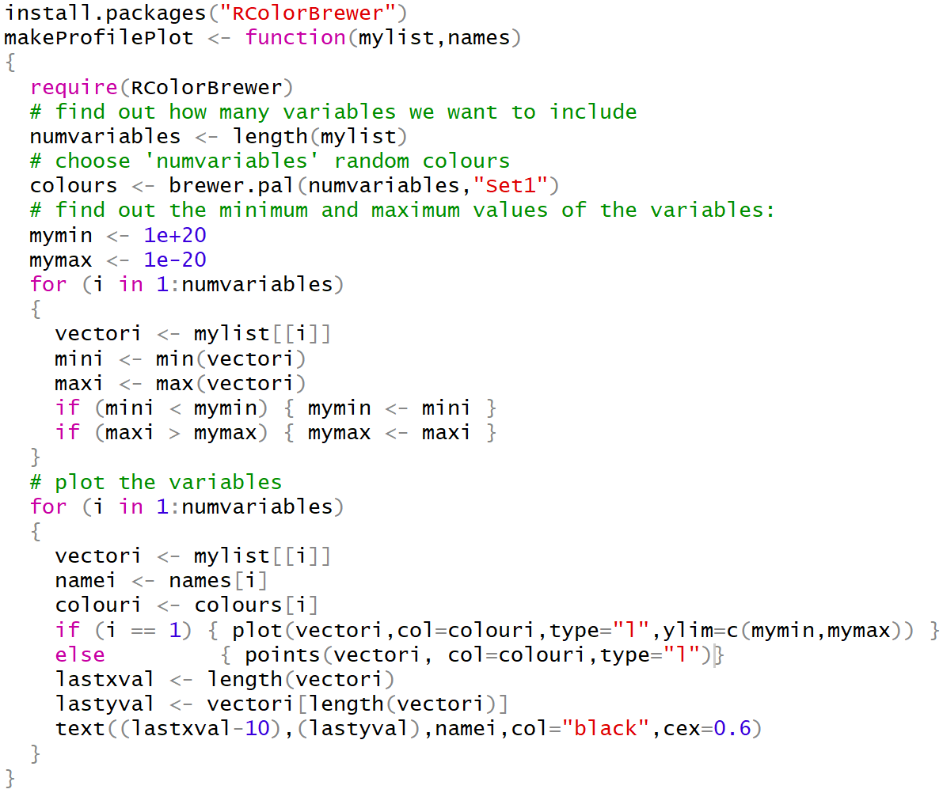
The makeprofile plot function

Slide 35
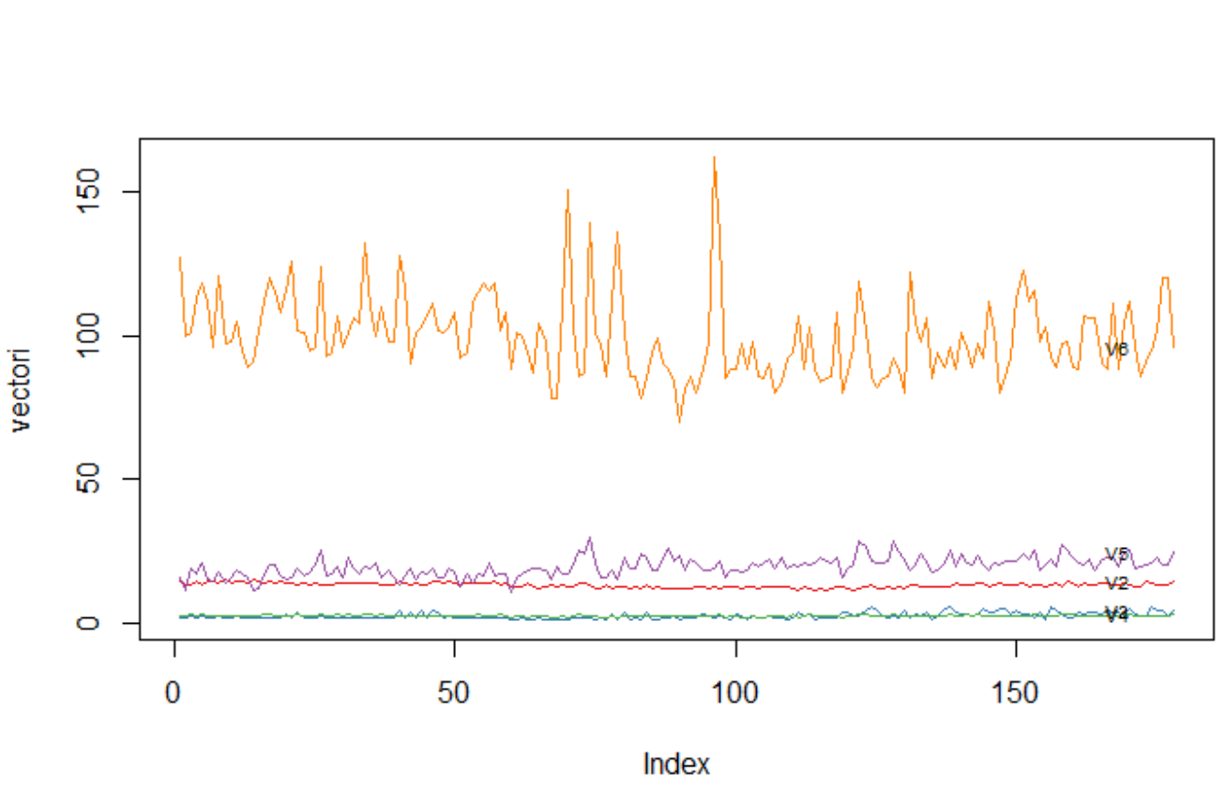
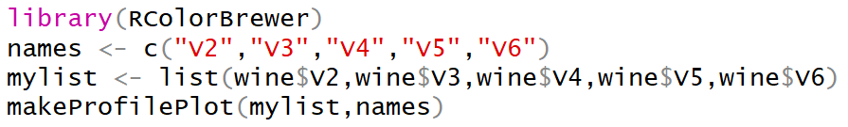
Make the profile plot
V3 and V4 are nearly the same in variation
V6 is the most different from V2-V5

Slide 36
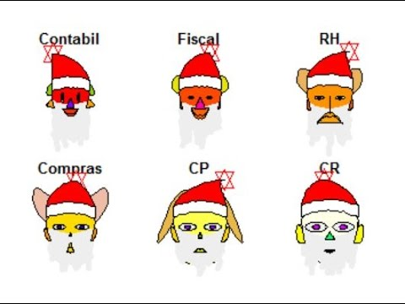
Chernoff faces
Image from https://www.youtube.com/watch?v=V6PVdpxNt9U

Slide 37
What is a Chernoff face plot?
See chapter 1 of the applied multivariate statistical analysis 6th edition textbook, pages 27-30
“Cheronff suggested representing p=dimensional observations as a two-dimensional face whose characteristics (face shape, mouth curvature, mose length, eye size, pupil position), are determined by the measurements on the p variables.”
Can handle up to p =18 variables

Slide 38
Why use Chernoff faces?
“Useful for verifying initial grouping suggested by subject-matter knowledge and intuition or final groupings produced by clustering algorithms” (page 28 of textbook)

Slide 39
Data, package, and function used
Reference: How to visualize data with cartoonish faces ala Chernoff (https://flowingdata.com/2010/08/31/how-to-visualize-data-with-cartoonish-faces/)
Package aplpack, used function faces()
Data is crime (crime rates by state): http://datasets.flowingdata.com/crimeRatesByState-formatted.csv

Slide 40
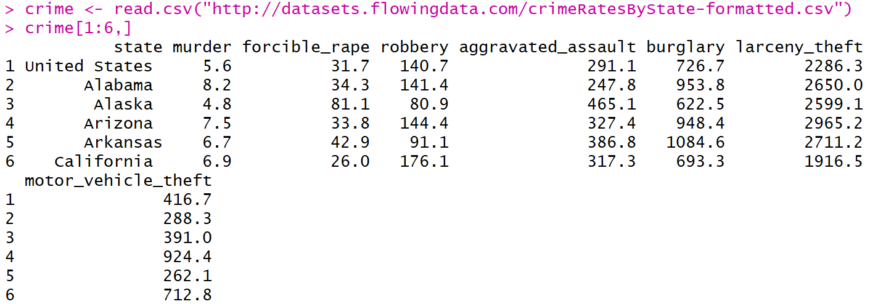
Crime data: a close look

Slide 41
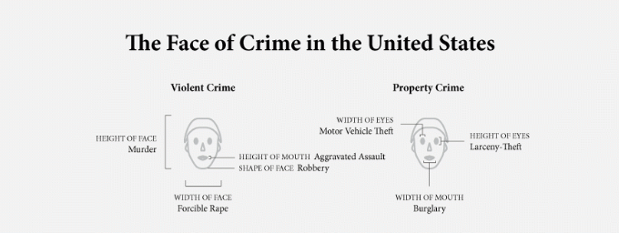
How to read the Chernoff faces in the crime data
Image cropped from https://flowingdata.com/2010/08/31/how-to-visualize-data-with-cartoonish-faces/#jp-carousel-20488

Slide 42
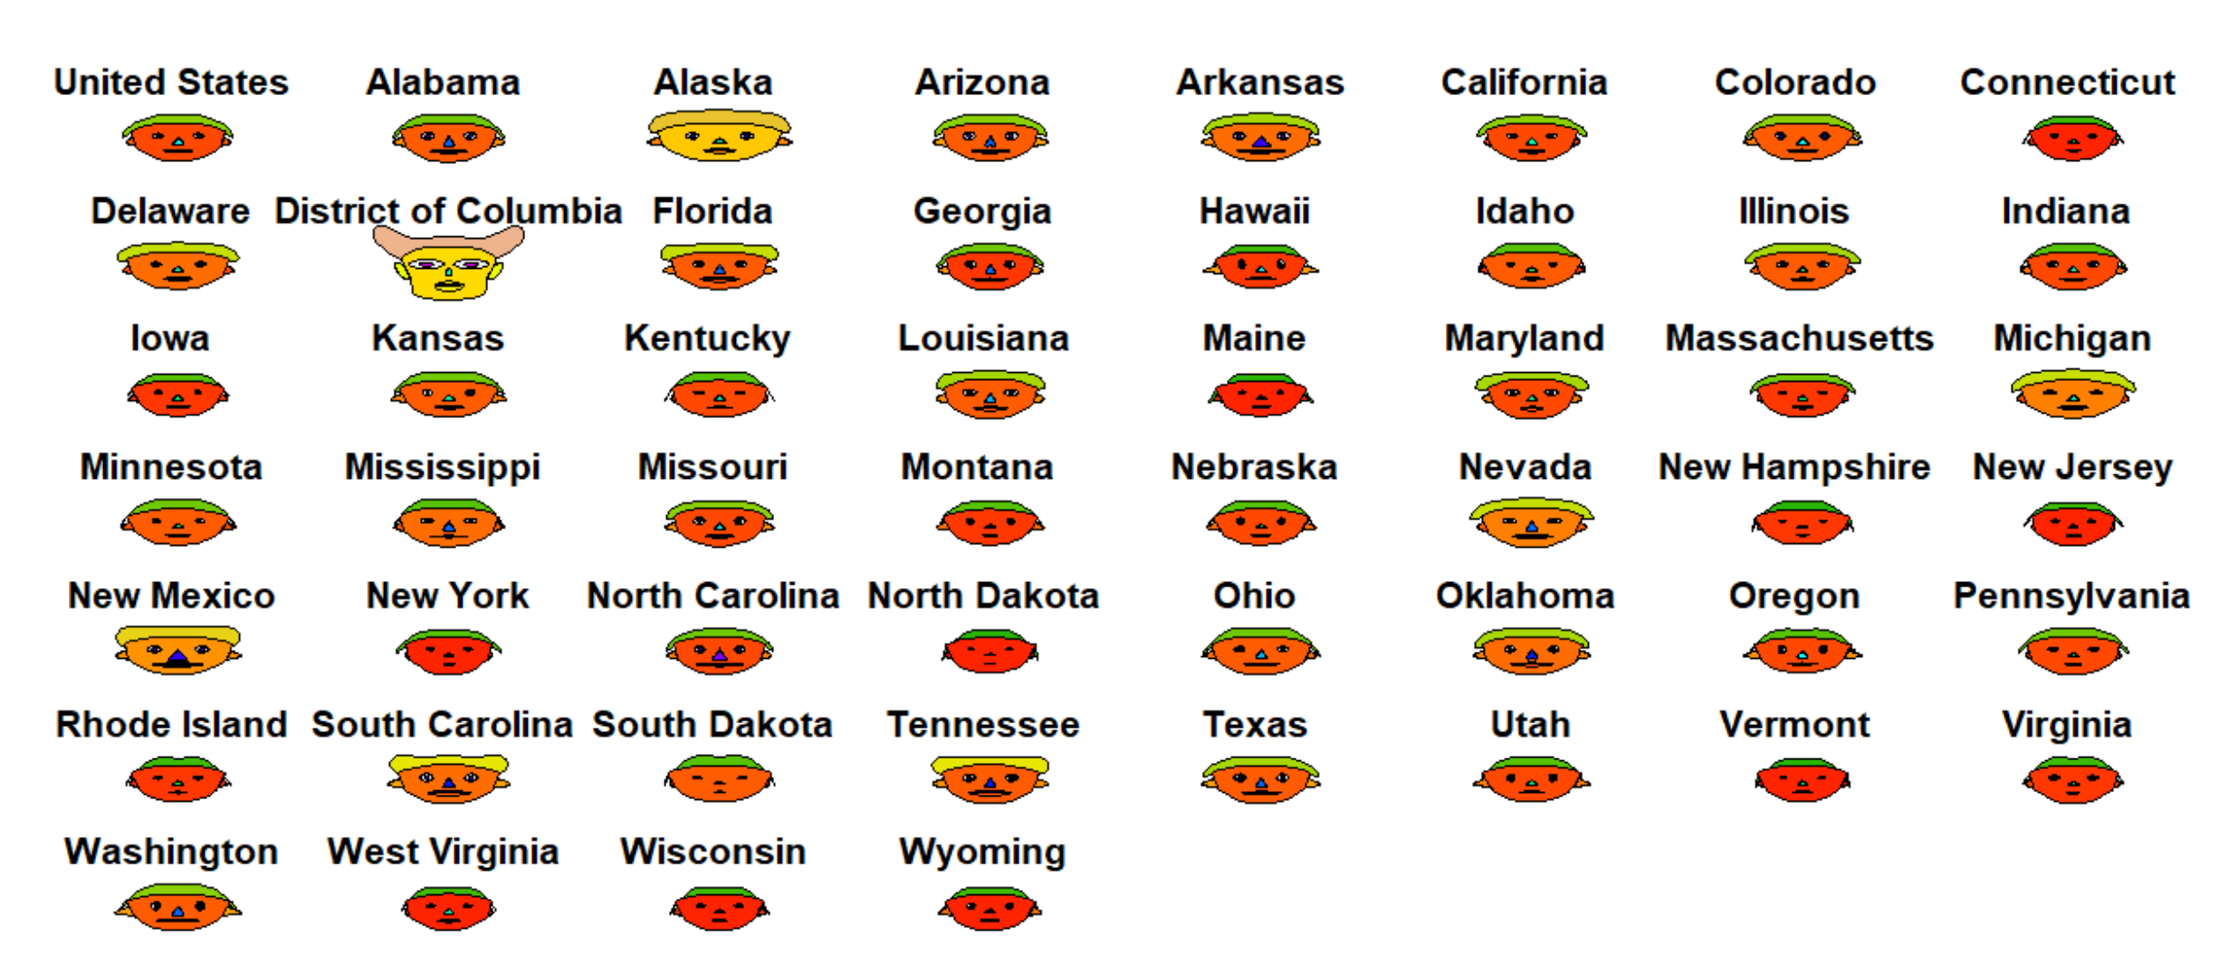
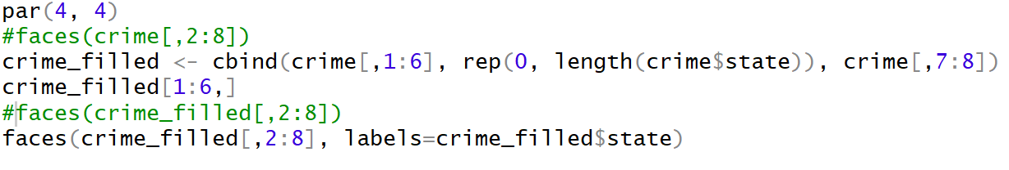
The resulting Chernoff faces

Slide 43

conclusions

Slide 44
References and resources
https://web.stanford.edu/class/bios221/labs/multivariate/lab_5_multivariate.html
https://rpkgs.datanovia.com/factoextra/
https://learnr.files.wordpress.com/2009/08/latbook.pdf
https://little-book-of-r-for-multivariate-analysis.readthedocs.io/en/latest/src/multivariateanalysis.html
https://flowingdata.com/2010/08/31/how-to-visualize-data-with-cartoonish-faces/
https://plot.ly/r/bubble-charts/
https://www.r-graph-gallery.com/142-basic-radar-chart.html
https://personality-project.org/r/html/spider.html
https://plot.ly/r/parallel-coordinates-plot/
https://stat.ethz.ch/R-manual/R-devel/library/MASS/html/parcoord.html

Slide 45

Thanks for your time

Slide 46
Questions?

